Slide 1
Relaxation Technique CFD
Dr. Ugur GUVEN

Slide 2
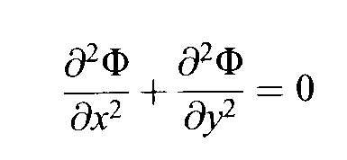
Elliptic Partial Differential Equations
Elliptic Partial Differential Equations are particularly useful for analyzing fluid flow that change upstream as well as downstream.
The most famous of these equations if the Laplace Equation.
Laplace Equation is used to give the velocity potential of inviscid incompressible irrotational flow

Slide 3
Solution by the Relaxation Method
Now you rewrite the Laplace Equation in terms of second order central differences.

Slide 4
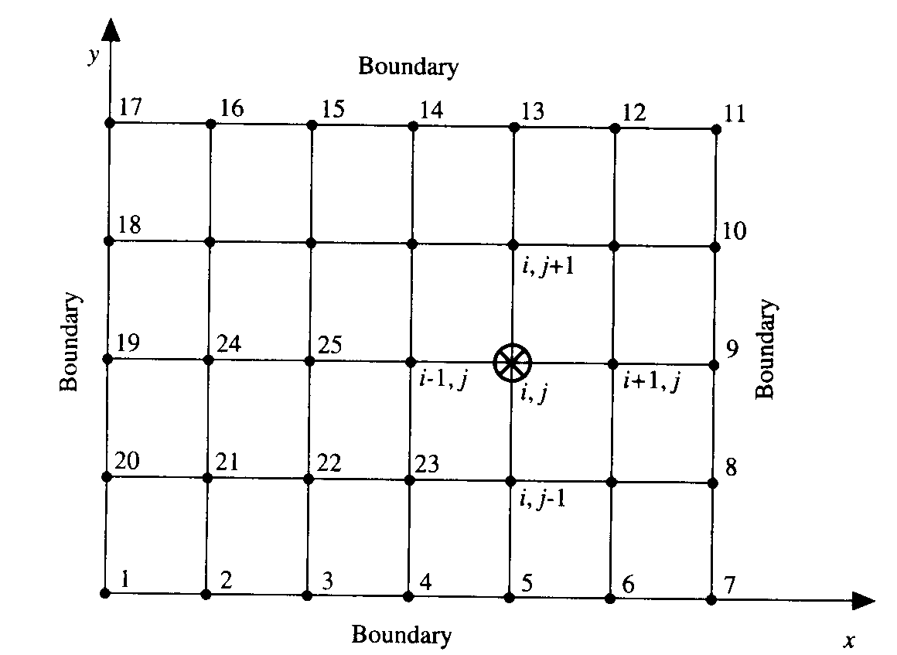
Grid for the Relaxation Technique

Slide 5
Relaxation Technique

Slide 6
Iterative Steps
Rewrite the equation obtained in the previous slide to solve for n+1 which is the number of iterations. Note that this is different form time marching technique as the flow variables don’t change over time, but they change over distance. (REMEMBER THE EQUATION DOESN’T HAVE dt TERMS)

Slide 7
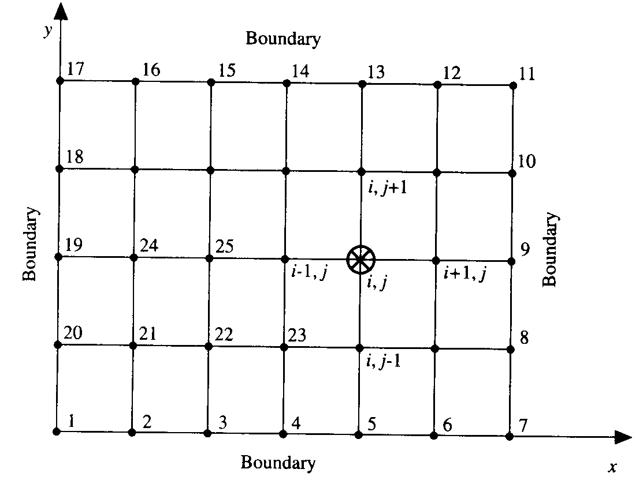
Iteration Steps
1 ) We already know the boundary values from 1 to 20, so we will use those.
2) Assume some value for the remaining 15 points.
3) Use the equation to solve for each 15 points.

Slide 8
Examples of the Iteration Steps
Since we already have fixed boundary values for nodes 1-20, lets apply the equation to node 21 for value n+1. (Remember we assumed values for the first step n=1)

Slide 9
Next Step
Now, when we are calculating Node 22, we can use the value from Node 21 that was calculated one step ago for better accuracy.
Do this for each of the 15 nodes in the grid.

Slide 10
Summary of Relaxation Technique
We continue to do this for every node until all 15 nodes have been written and calculated for a single iteration.
Repeat these steps for as many iterations as possible (minimum 10) for more accurate results.
Use calculated results in your new node calculations whenever possible.

Slide 11
Thank You
You can download this lecture at
www.cfdlectures.co.cc
drguven@live.com

